Slide 1
CII3B4 Pemrograman Berorientasi Objek
Inheritance

Slide 2
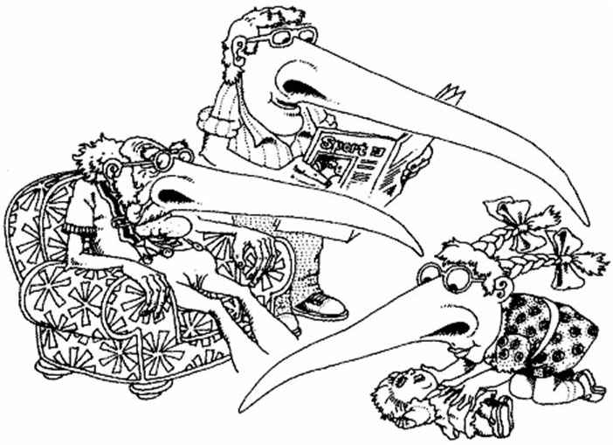
What is Inheritance?

Slide 3

Inheritance
The ability of a java class to ‘pass down’ all or some of their fields, attributes, and methods to another class that will be referred to as their child class
Child class will be able to recognize the inherited fields and methods, and can use it without declaring or defining again

Slide 4

Inheritance
Inheritance is an implementation of generalization-specialization class relationship or "is-a" relationship
In short : it’s the mechanism by which one class acquires the properties of another class

Slide 5
Inheritance
Denoted by arrows (hollow and triangular head)
The classes that passed down the attributes and methods are called
parent class, super class, or base class
The classes that inherit the attributes and methods are called
Child class, subclass, or derived class
Parent Class
Child Class

Slide 6
Types of Inheritance
Single Inheritance
Child class inherit from 1 parent class
Multiple Inheritance
Child class inherit from many parent classes
parent class
child class
parent class-1
parent class-n
. . .
child class

Slide 7
Java Class Inheritance
Single inheritance only
Using keyword extends
All non-private attributes and methods are passed on
To access the properties of parent
Use "super" keyword
class ChildClass extends ParentClass{
// child class attributes
// child class methods
}

Slide 8
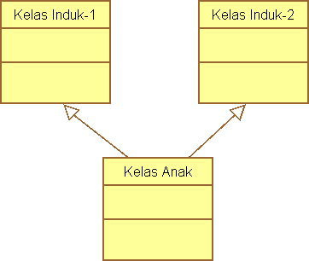
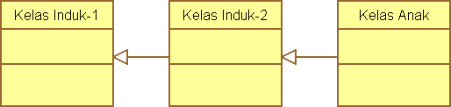
Multiple Inheritance in Java
Multiple Inheritance is handled using staged single inheritance
A
B
C
D
A
B
A
B
C
D
A
B
C
D
E
F
A
B
C
D
Multiple Inheritance using Staged Single Inheritance
E
F
Base Multiple Inheritance

Slide 9

Example - Method Inheritance
public class Parent{
public String methodParent(){
return "this is method Parent";
}
}
public class Child extends Parent{
public String methodChild(){
return "this is method Child";
}
}
public class Driver{
public static void main(String args[]){
Parent p = new Parent();
Child c = new Child();
System.out.println(p.methodParent());
System.out.println(c.methodParent());
System.out.println(c.methodChild());
System.out.println(p.methodChild());
}
}
> This is method Parent
> This is method Parent
> This is method Child
> error: cannot find symbol
Child can access public method of Parent, but not vice versa

Slide 10
Example – Variable Inheritance
public class Parent{
public int publicInt;
private int privateInt;
int defaultInt;
}
public class Child extends Parent{
public void methodChild(){
publicInt = 10;
privateInt = 20;
defaultInt = 30;
}
}
error: privateInt has private access

Slide 11
Example
public class Parent{
public int publicInt;
private int privateInt;
int defaultInt;
public void setPrivateInt(int privateInt){
this.privateInt = privateInt;
}
}
public class Child extends Parent{
public void methodChild(){
publicInt = 10;
setPrivateInt(20);
defaultInt = 30;
}
}

Slide 12
Example
package test;
public class Parent{
public int publicInt;
private int privateInt;
int defaultInt;
public void setPrivateInt(int privateInt){
this.privateInt = privateInt;
}
}
import test.Parent;
public class Child extends Parent{
public void methodChild(){
publicInt = 10;
setPrivateInt(20);
defaultInt = 30;
}
}
error: defaultInt is not public in Parent; cannot be accessed from outside package

Slide 13

Access Modifier Protected
All class in the same package
All subclass (child class) even in different package

Slide 14
Example
package test;
public class Parent{
public int publicInt;
private int privateInt;
int defaultInt;
protected int protectedInt;
public void setPrivateInt(int privateInt){
this.privateInt = privateInt;
}
}
import test.Parent;
public class Child extends Parent{
public void methodChild(){
publicInt = 10;
setPrivateInt(20);
protectedInt = 30;
}
}
public class Driver{
public static void main(String args[]){
Child c = new Child();
c.methodChild();
}
}
Modification to protectedInt done by Child class

Slide 15
Example
package test;
public class Parent{
public int publicInt;
private int privateInt;
int defaultInt;
protected int protectedInt;
public void setPrivateInt(int privateInt){
this.privateInt = privateInt;
}
}
import test.Parent;
public class Child extends Parent{
}
public class Driver{
public static void main(String args[]){
Child c = new Child();
c.publicInt = 10;
c.setPrivateInt(20);
c.protectedInt = 40;
}
}
error: protectedInt has protected access in parent
(protectedInt is owned by Parent in different package)

Slide 16
Overriding
Redefining field or method inherited by Parent class in Child class (Polymorphism)
subclass can implement a parent class method more specifically based on its requirement.
When overriding a field or method, the Child class will have access to both the original parent field/method and the new redefined child field/method
Call parent’s field/method using keyword "super"
Keyword "super" only available inside the child class

Slide 17
Example
public class Parent{
public String toString(){
return "this is method Parent";
}
}
public class Child extends Parent{
}
public class Driver{
public static void main(String args[]){
Child c = new Child();
Parent p = new Parent();
System.out.println(p.toString());
System.out.println(c.toString());
}
}
> this is method Parent
> this is method Parent

Slide 18
Example
public class Parent{
public String toString(){
return "this is method Parent";
}
}
public class Child extends Parent{
public String toString(){
return "this method overridden
by Child";
}
}
public class Driver{
public static void main(String args[]){
Child c = new Child();
Parent p = new Parent();
System.out.println(p.toString());
System.out.println(c.toString());
}
}
> this is method Parent
> this method overridden by Child

Slide 19
Example
public class Parent{
public String toString(){
return "this is method Parent";
}
}
public class Child extends Parent{
public String toString(){
return "this method overridden
by Child";
}
public String toStringParent(){
return super.toString();
}
}
public class Driver{
public static void main(String args[]){
Child c = new Child();
Parent p = new Parent();
System.out.println(p.toString());
System.out.println(c.toString());
System.out.println(c.toStringParent());
}
}
> this is method Parent
> this method overridden by Child
> this is method Parent

Slide 20
Example
public class Parent{
protected int number;
}
public class Child extends Parent{
private int number;
public void methodChild(){
number = 10;
super.number = 20;
System.out.println(number);
System.out.println(super.number);
}
}
public class Driver{
public static void main(String args[]){
Child c = new Child();
c.methodChild();
}
}
> 10
> 20

Slide 21
Example
public class Parent{
protected int number;
public void setNumber(int number){
this.number = number;
}
public int getNumber(){
return number;
}
}
public class Child extends Parent{
private int number;
public void methodChild(){
number = 10;
super.number = 20;
}
}
public class Driver{
public static void main(String args[]){
Child c = new Child();
c.methodChild();
System.out.println(c.getNumber());
}
}
> 20
setNumber() and getNumber() is owned by parent, accessing number value from parent (super)

Slide 22
Example
public class Parent{
protected int number;
public void setNumber(int number){
this.number = number;
}
public int getNumber(){
return number;
}
}
public class Child extends Parent{
private int number;
public void methodChild(){
number = 10;
super.number = 20;
}
public int getNumber(){
return number;
}
}
public class Driver{
public static void main(String args[]){
Child c = new Child();
c.methodChild();
System.out.println(c.getNumber());
}
}
> 10
If it’s overridden, the method will access child field first

Slide 23
Non-Access Modifier Final
To limit the access to modify the class, field, or method
Final modifier in method
Method cannot be overridden by child class, for use only
public final void finMethod(){ … }
public class Parent{
public void publicMethod(){
}
final public void finMethod(){
}
}
public class Child extends Parent{
public void publicMethod(){
}
public void finMethod(){
}
}
//ok
// forbidden

Slide 24
Non-Access Modifier Final
Final modifier in class
Class cannot be extended (subclassed) by other class
public final class FinClass{ … }
Public final class FinalParent{
}
public class Child extends FinalParent{
}
// forbidden

Slide 25
Non-Access Modifier Final
Final modifier in field/variable
Field/variable is constant, value set when declared or initiated in constructors, and cannot be changed afterward
private final double finDouble
represent final constants in all uppercase, using underscore to separate words
public class Driver{
public static void main(String args[]){
final int a = 5;
final int b;
b = 8;
a = 15;
b = 21;
}
}
// forbidden
// forbidden

Slide 26
Non-Access Modifier Final
Final modifier in Reverence Variable
Once the variable refers to an object, the variable cannot be re-bound to reference another object.
But the object that it references is still mutable, if it was originally mutable.
private final ClassName finObject;

Slide 27
Non-Access Modifier Final
public class Parent{
int number;
public void setNumber(int number){
this.number = number;
}
public int getNumber(){
return number;
}
}
public class Driver{
public static void main(String args[]){
Parent p = new Parent();
final Parent fp1 = new Parent();
final Parent fp2;
fp2 = p;
fp1 = p;
fp2 = new Parent();
fp2.setNumber(5);
fp1.setNumber(20);
}
}
// forbidden
// forbidden

Slide 28
Constructor is not inherited
If there is only non-default constructor(s) in parent class
There must be at least one child constructor that invokes one parent constructor
Every constructors in child class must invoke one parent constructor
Invoke parent constructor using method super(parameter)
If there is a default constructor in parent class
the child class does not have to invoke the parent constructor

Slide 29
Example
public class Parent{
protected int vP1;
protected double vP2;
public Parent(){
}
public void methodParent(){
}
}
public class Child extends Parent{
private int vC;
public Child(int vC){
this.vC = vC;
}
public void methodChild(){
}
}
If there is a default constructor or no constructor at all present at parent class, then child class does not have to invoke parent class constructor
child class may or may not have its own constructor

Slide 30
Example
public class Parent{
protected int vP1;
protected double vP2;
public Parent(int vP1){
this.vP1 = vP1;
}
public Parent(int vP1,double vP2 ){
this.vP1 = vP1;
this.vP2 = vP2;
}
public Parent(double vP2 ){
this.vP2 = vP2;
}
public void methodParent(){
}
}
public class Child extends Parent{
private int vC;
public Child(int vC, double vP){
this.vC = vC;
super(vP);
}
public void methodChild(){
}
}
If there are non-default constructors in parent class, There must be AT LEAST one child constructor that invokes one parent constructor
Use keyword super() to invoke parent constructor

Slide 31
Example
public class Parent{
protected int vP1;
protected double vP2;
public Parent(int vP1){
this.vP1 = vP1;
}
public Parent(int vP1,double vP2 ){
this.vP1 = vP1;
this.vP2 = vP2;
}
public Parent(double vP2 ){
this.vP2 = vP2;
}
public void methodParent(){
}
}
public class Child extends Parent{
private int vC;
public Child(int vC, double vP){
this.vC = vC;
super(vP);
}
public Child(double vP){
super(5, vP);
}
public Child(){
super(2.5);
}
public void methodChild(){
}
}
All child constructor must invoke parent constructor

Slide 32
Example
public class Parent{
protected int vP1;
protected double vP2;
public Parent(){
vP1 = 50;
}
public Parent(int vP1,double vP2 ){
this.vP1 = vP1;
this.vP2 = vP2;
}
public Parent(double vP2 ){
this.vP2 = vP2;
}
public void methodParent(){
}
}
public class Child extends Parent{
private int vC;
public Child(int vC, double vP){
super(vC, vP);
}
public Child(int vC){
this.vC = vC;
}
public Child(){
this.vC = 25;
}
public void methodChild(){
}
}
Child constructors that did not invoke any parent constructor will automatically invoke the default parent constructor
If parent class has default constructor, then the child class may or may not invoke the parent constructor at all

Slide 33
When to Use
Specialization
Top-down view
Generalization
Bottom-up view

Slide 34
Specialization
Bird

Slide 35
Specialization
Bird
Gull
Eagle
Dove

Slide 36
Generalization
?
Eraser
Pen
Ruler

Slide 37
Generalization
Stationery
Eraser
Pen
Ruler

Slide 38
Specialization or Generalization ?
Stationery
Eraser
Pen
Ruler

Slide 39
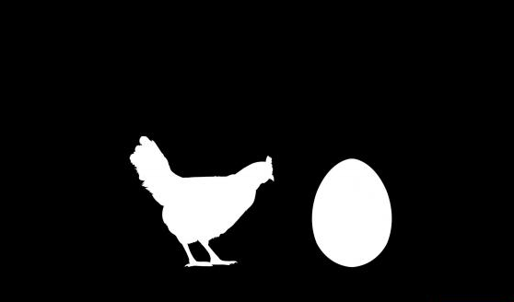
Generalisasi & Spesialisasi

Slide 40
When to use
Top-Down View
to create a new classes with some behavior that already exists in other class (or similar with other class)
to create more specific classes or modification from a base class
to break down a large class to more specific classes
to create a form of class hierarchy
For those reasons we can create subclasses that inherit the base class

Slide 41
When to use
Bottom-Up View
When there several classes that generally the same (many methods and fields are the same or similar) but not necessary that one of the class is to be the child of another
To create a module to interacts between classes
For those reasons we can create a parent class that collects the other classes as its child classes

Slide 42
Benefit of Inheritance
Reusability
Reuse the methods and data of the existing class
Extends
Adding new data and new methods to the existing class
Modify
Modify the existing class by overloading its methods with your won implementation
Reduction (Grouping and Organizing)

Slide 43
5 things you might find in an Inheritance Hierarchy:
superclass is too general to declare all behavior, so each subclass adds its own behavior
superclass legislates an abstract behavior and therefore delegates implementation to its subclasses
superclass specifies behavior, subclasses inherit behavior
superclass specifies behavior, subclasses can choose to override behavior completely
just because a subclass inherits a method doesn’t mean that it must act in the same way as its superclass
subclass can choose to reject its superclass’ implementation of any method and "do it my way"
superclass specifies behavior, subclasses can choose to override behavior in part
called partial overriding

Slide 44
Question?

